Slide 1
Global Information Security Society for Professionals of Pakistan
Topic : AWS Security
Speaker’s Name : Sabir Mustafa مصطفٰی))

Slide 2
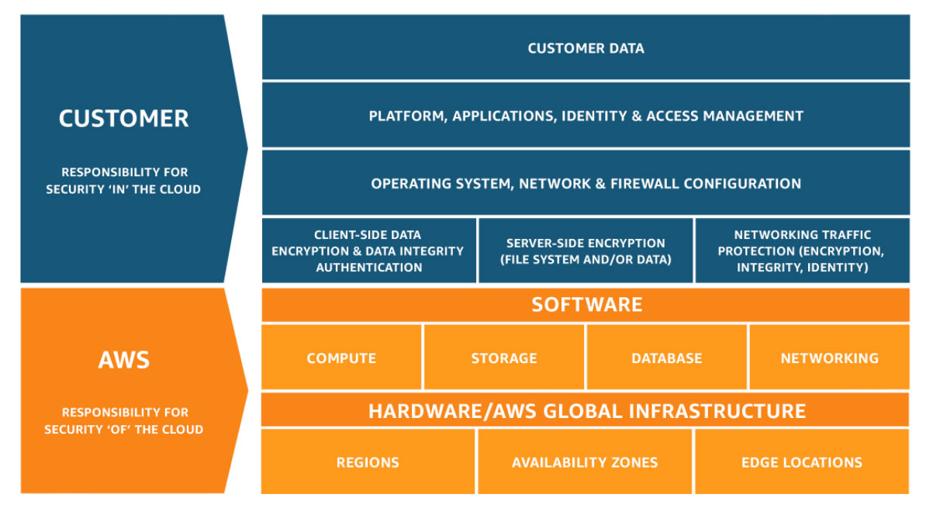
Standard Shared responsibility model

Slide 3
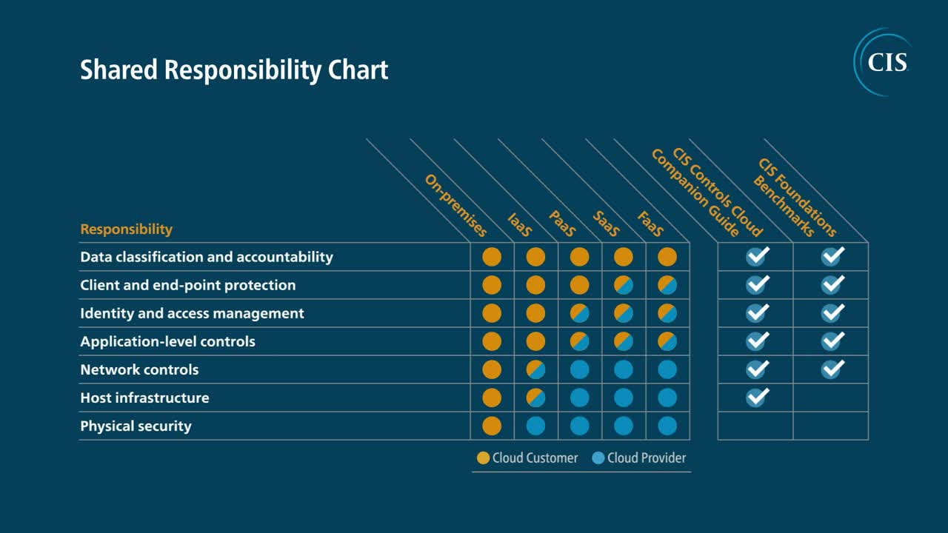
Shared Responsibility by CIS

Slide 4
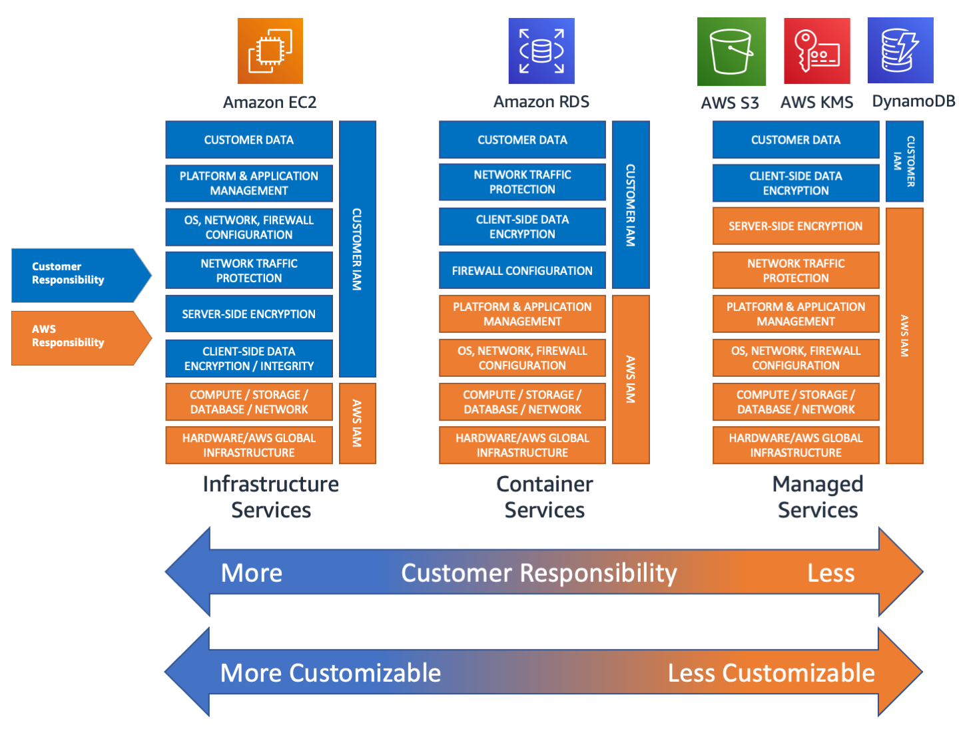
In-depth Responsibility Model Approach

Slide 5
Security by Design
Segregate account environment
Implement strong identity foundation
Enable traceability
Automate security best practices
Data protection in-transit and at-rest

Slide 6
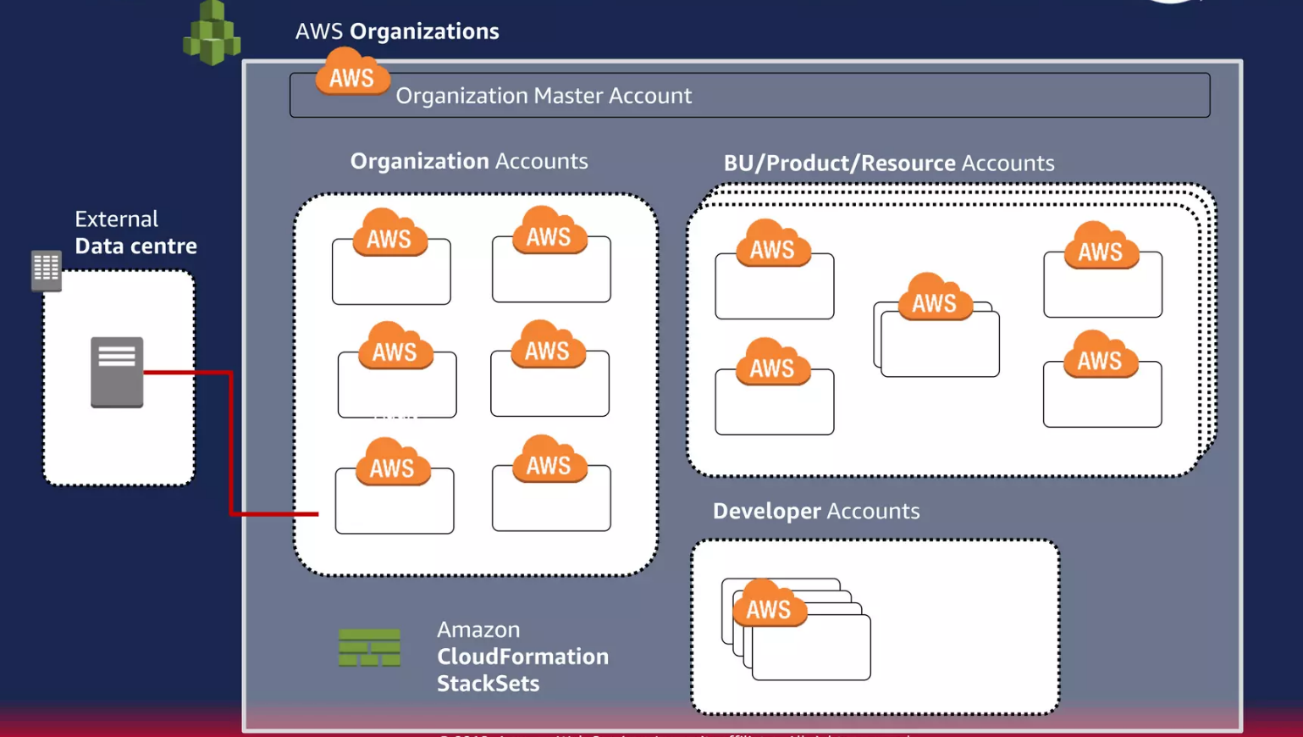
Segregated Environments
Implement multi-account architecture
Leverage AWS Organizations

Slide 7




Implement strong identity foundation
Ensure only authenticated and authorized users are able to access resources
Users
Groups
Services
Roles
Think carefully
SAML 2.0
Define a management policy
Logically group users
Apply group policies
Least privilege access
Be granular
Use roles for instances and functions
Avoid using API keys in code

Slide 8
Protect AWS credentials
Establish least-privileged user access
Enable MFA on the root account
Set password policy as per organization security guidelines
Enforce MFA for sensitive operations like s3 delete etc
Avoid storing API keys in source control, use AWS Secrets manager
Use temporary credentials via AWS STS
Use AWS Organization to centrally manage access and policies
Deploy AWS native threat detection service ie GuardDuty

Slide 9


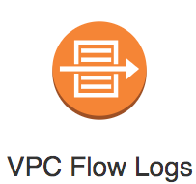
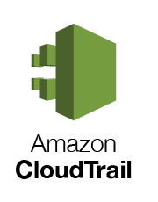
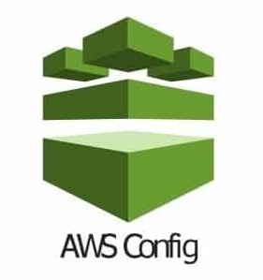
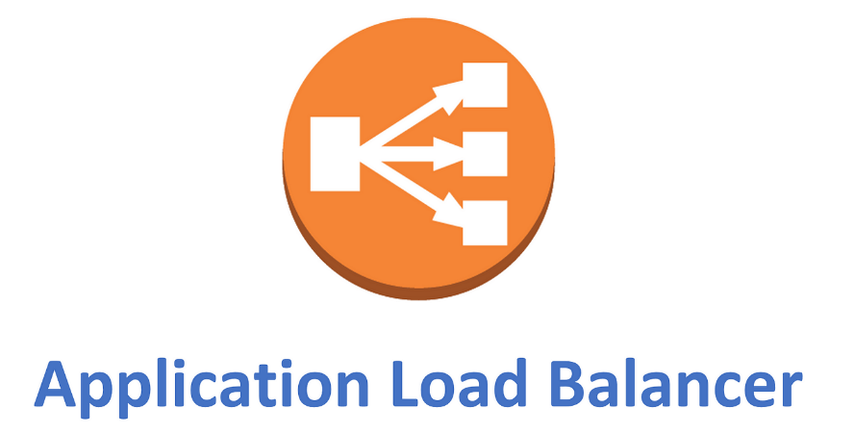
Use detective controls and services
Capture and analyze logs
Integrate auditing controls with notifications and workflows

Slide 10
Log Categories
AWS Infra logs | AWS service logs | Host-based logs
AWS CloudTrail | Amazon S3 | Messages
AWS VPC Flow logs | ALB | NGNIX/Apache
RDS logs…… | CloudFront | Syslogs…..
 | Elasticbeanstalk….
The host-based logs require cloudwatch agent to be installed. Once installed, it pushes host logs to Cloudwatch logs

Slide 11
Automating responses
AWS CloudTrail → AWS Cloudwatch logs → AWS Cloudwatch alerts
AWS CloudTrail → AWS SNS → AWS Lambda
AWS Config rules (Compliance validation)
Amazon Inspector (host-based compliance checking)

Slide 12
Automate security best practices
Template everything (Terraform, OpenTofu etc)
Use CI/CD Pipelines
Set customer AWS Config rules
Schedule Amazon Inspector scans
Automate response to non-compliant infrastructure

Slide 13
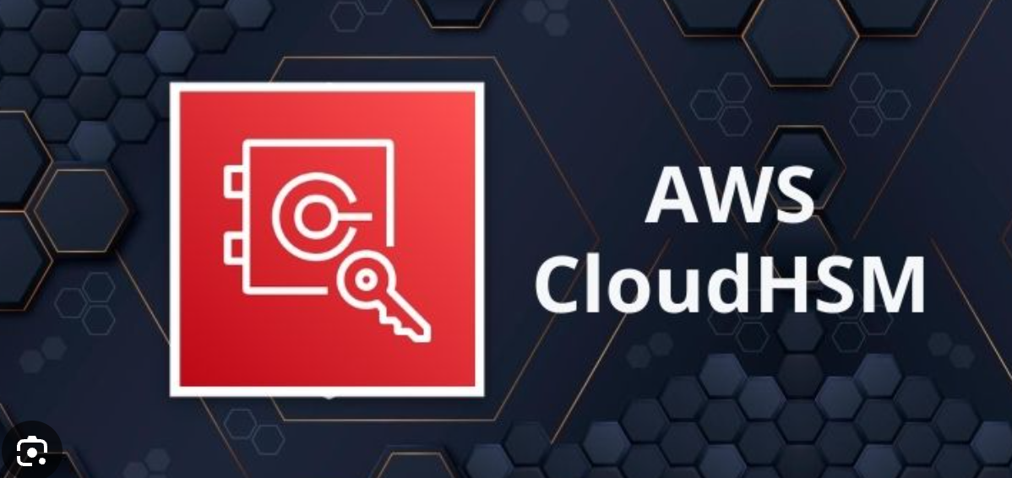

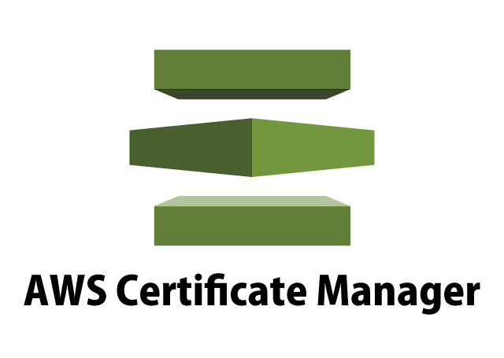
Data protection at-rest and in-transit

Slide 14
Reference Diagrams

Slide 15
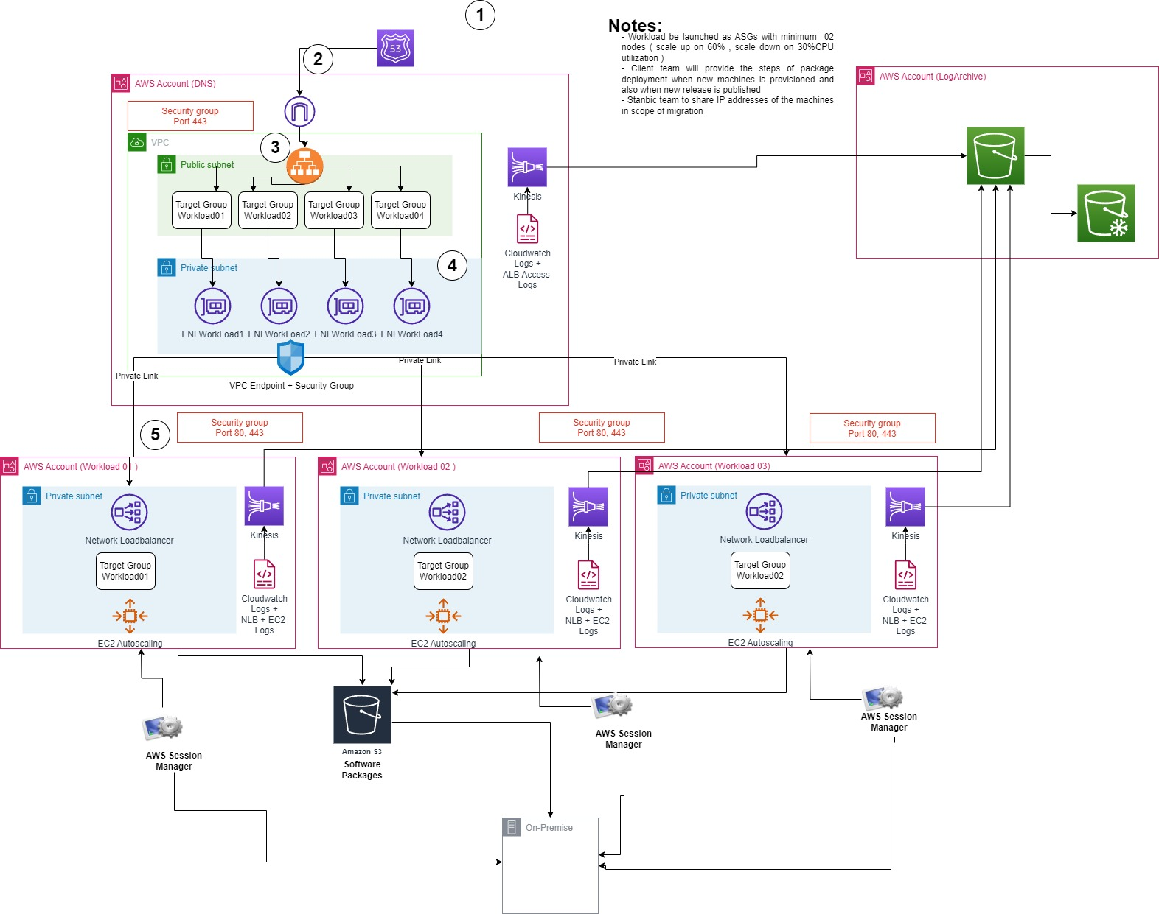
Secure workload publishing

Slide 16
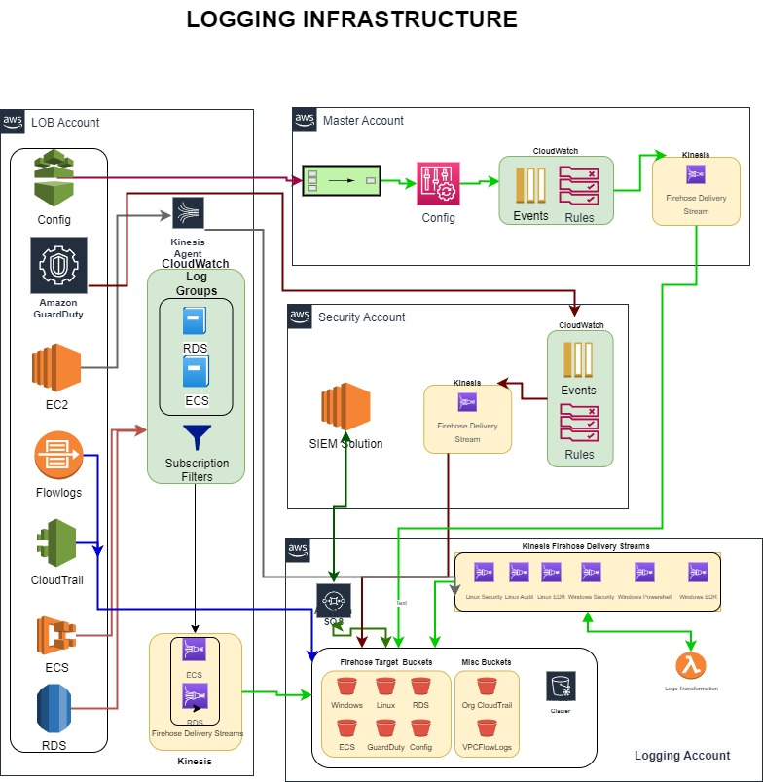
Centralize Logging

Slide 17
Useful Links
https://pages.awscloud.com/apn-tv-authority-to-operate-ep-007.html?trk=apn-tv-carousel
https://aws.amazon.com/iam/
https://docs.aws.amazon.com/STS/latest/APIReference/Welcome.html
https://aws.amazon.com/organizations/
https://aws.amazon.com/config/
https://docs.aws.amazon.com/config/latest/developerguide/managed-rules-byaws-config.html
https://aws.amazon.com/kms/
https://d0.awsstatic.com/whitepapers/KMS-CryptographicDetails.pdf
https://csrc.nist.gov/CSRC/media/projects/cryptographic-module-validationprogram/documents/security-policies/140sp3139.pdf
https://aws.amazon.com/cloudhsm/
https://aws.amazon.com/architecture/well-architected/
https://d1.awsstatic.com/whitepapers/architecture/AWS-SecurityPillar.pdf
https://d0.awsstatic.com/whitepapers/compliance/AWS_CIS_Foundations_Benchmark.pdf
https://docs.aws.amazon.com/kms/latest/developerguide/crypto-intro.html

Slide 18

THANKS

